Slide 1
DPM Meeting 5
Post-Demo

Slide 2
Gantt Chart

Slide 3
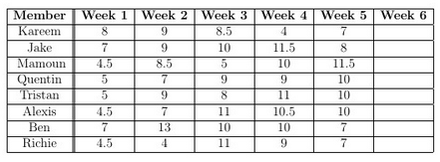
Budget
Week 4:
Kareem
Helped with search algorithm
Gantt updates and Presentation
Jake
Worked on LDD model
Helped plan out grabbing test
Wrote out integration testing and grabbing document
Started the Final Report
Tristan & Alexis:
Completed localization and WiFi connection
Worked on the search algorithm, block pick-up and started obstacle avoidance
Mamoun & Richie:
Wrote out integration testing document
Worked on wheel and width calibration
Quentin & Ben:
Worked on hardware iterations, and testing
Worked on hardware and testing documentation

Slide 4
Software
Localization and WiFi connection final versions
Developed for the demo (version 2.3), but improvements needed:
Navigation to the zone
Search point and stack point
Search algorithm
Block capture
Started obstacle avoidance and updated search
Need to implement odometry correction

Slide 5
Hardware
Small changes to last week’s version
Length minimized
Front sensor heights optimized
Tower arms strengthened
Main design finalized (Versions 3.XX)
Small changes could still occur
Sensor placement
Tower height
Tower arm width
More grippers?

Slide 6
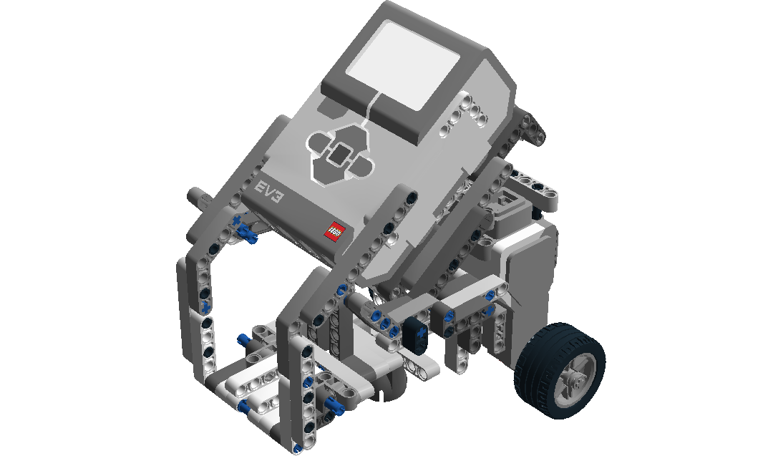
Documentation
Integration Test
Document written with testing team and ready to go
Poster
Further work and redesign may be needed
LDD
Chassis is taking longer than expected
Final Report
Started working on introduction
Template?

Slide 7
Final Push
LDD
Perfecting Obstacle Avoidance and Stacking
Odometry Correction
Final Report
Poster
Final Integration Testing
Win the Competition!

